Slide 1
DevOps 4 webMethods.io
Srinivasan Sabapathy

Slide 2

DevOps 4 webMethods.io
AGENDA
DevOps Requirement & Benefits
Overview
GIT Workflow
Delivery / Deployment Overview
Implementation to Delivery Flow
Demo
Scope, Assumptions & Pre-requisites
Demo

Slide 3
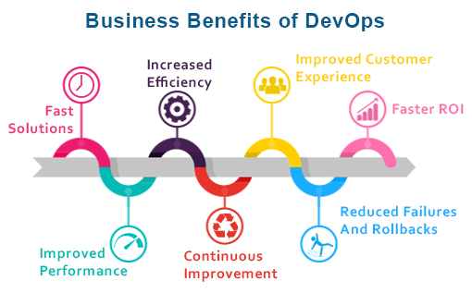
Requirement & Benefits
Faster release rate, hence faster “to Market”
Fault Isolations
Faster Mean Time To Resolutions (MTTR)
Test Repeatability and Reliability
Greater visibility into system outcomes
Notes:
MTTR measures the maintainability of repairable features and sets the average time to repair a broken feature. Basically, it helps you track the amount of time spent to recover from a failure.
CI/CD reduces the MTTR because the code changes are smaller and fault isolations are easier to detect. One of the most important business risk assurances is to keep failures to a minimum and quickly recover from any failures that do happen. Application monitoring tools are a great way to find and fix failures while also logging the problems to notice trends faster.

Slide 4
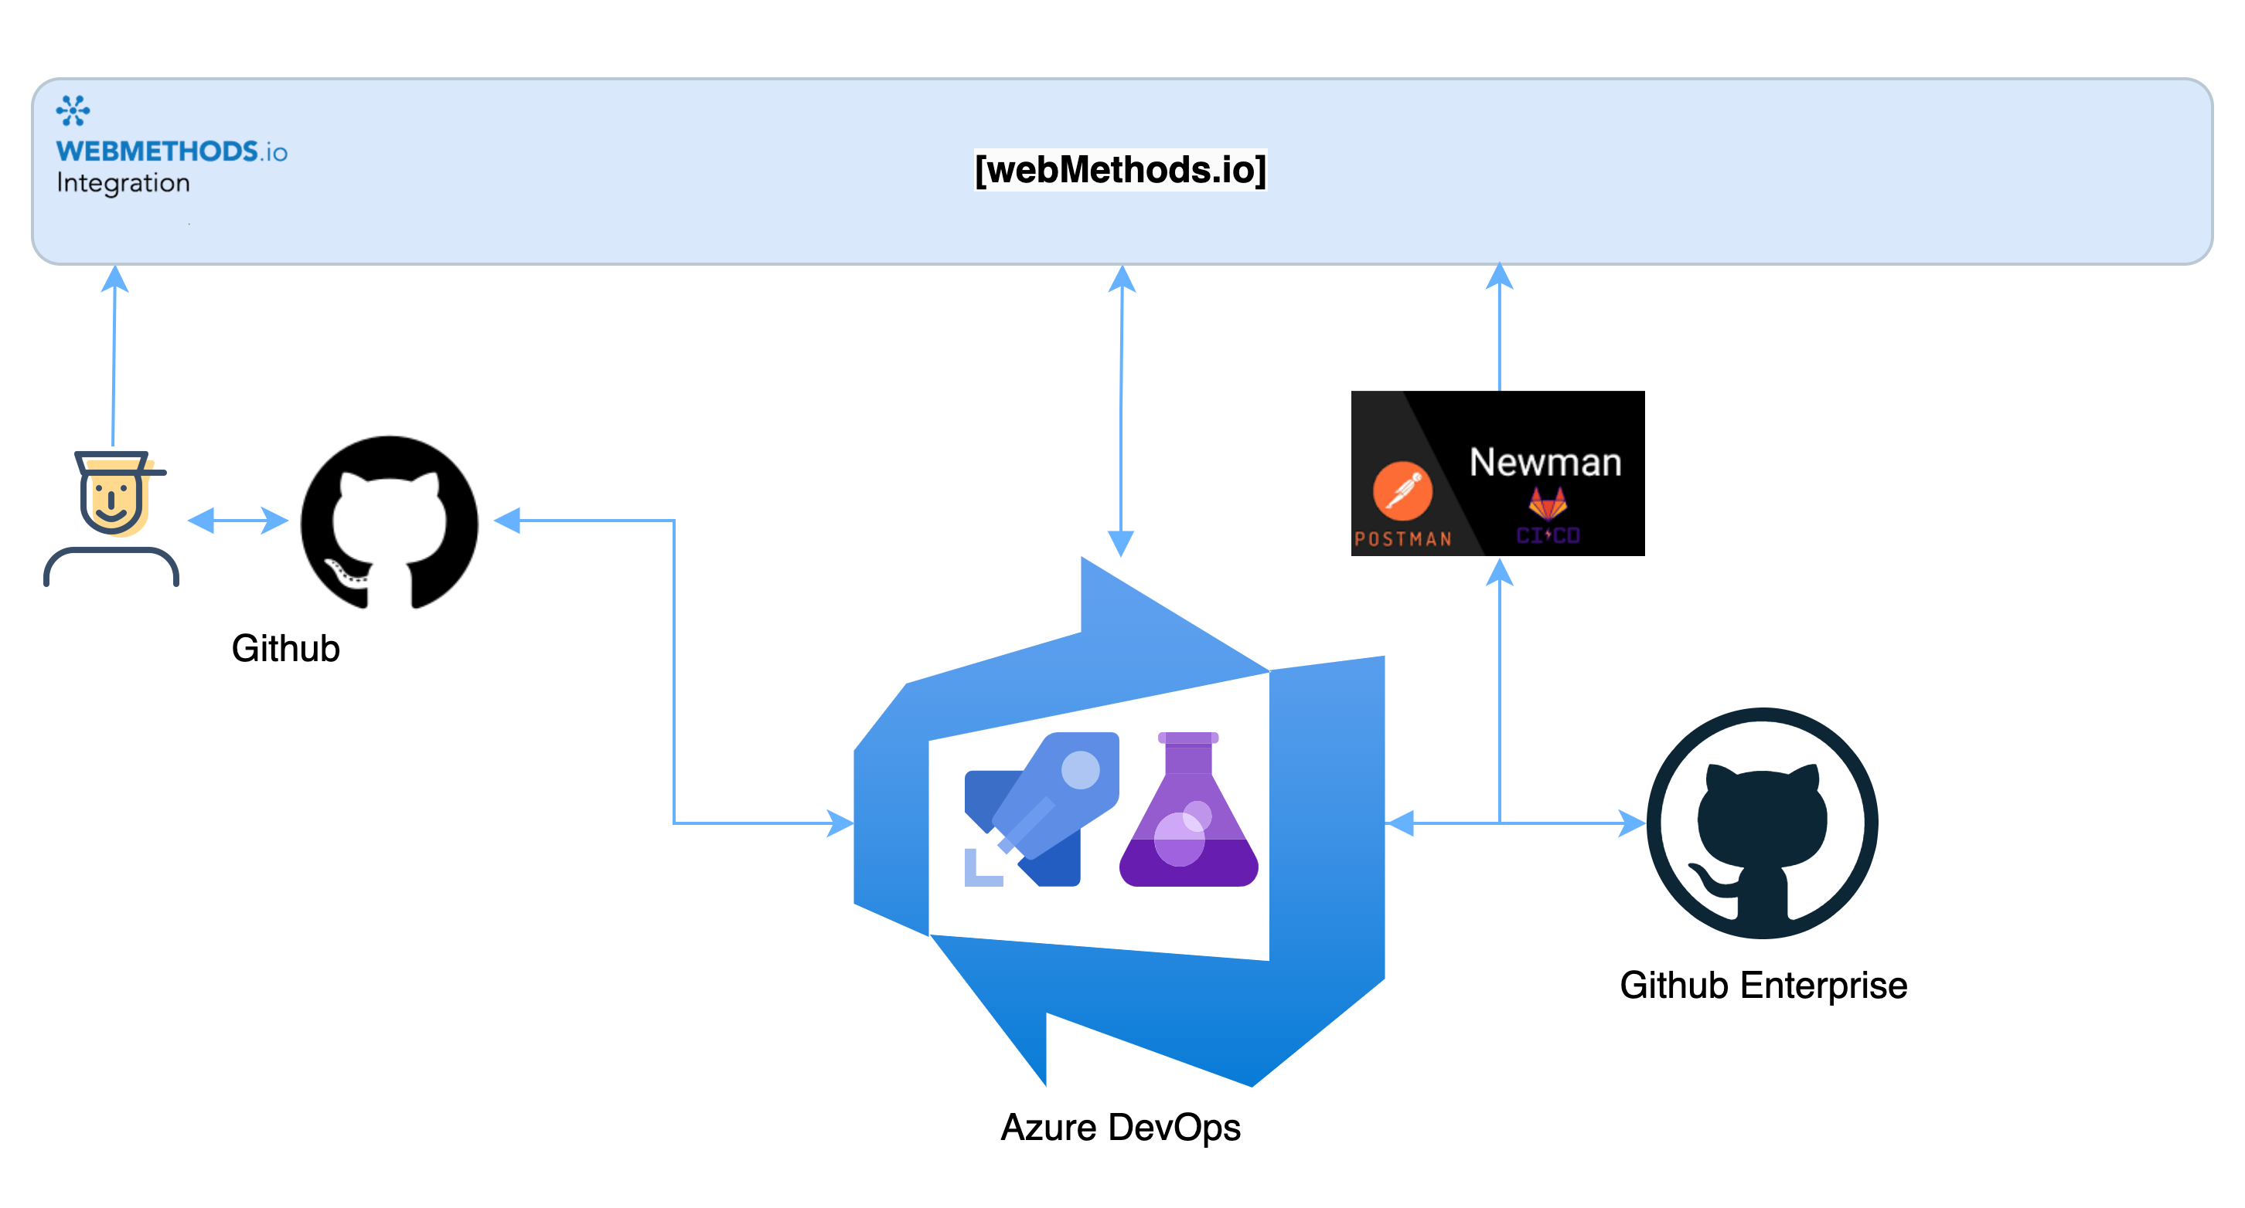
Context
Context & Background
Below are the assumptions made for further discussions
4 Environments
Play/Build, Dev, QA and Prod
Automation / Orchestration platform
Azure DevOps

Slide 5
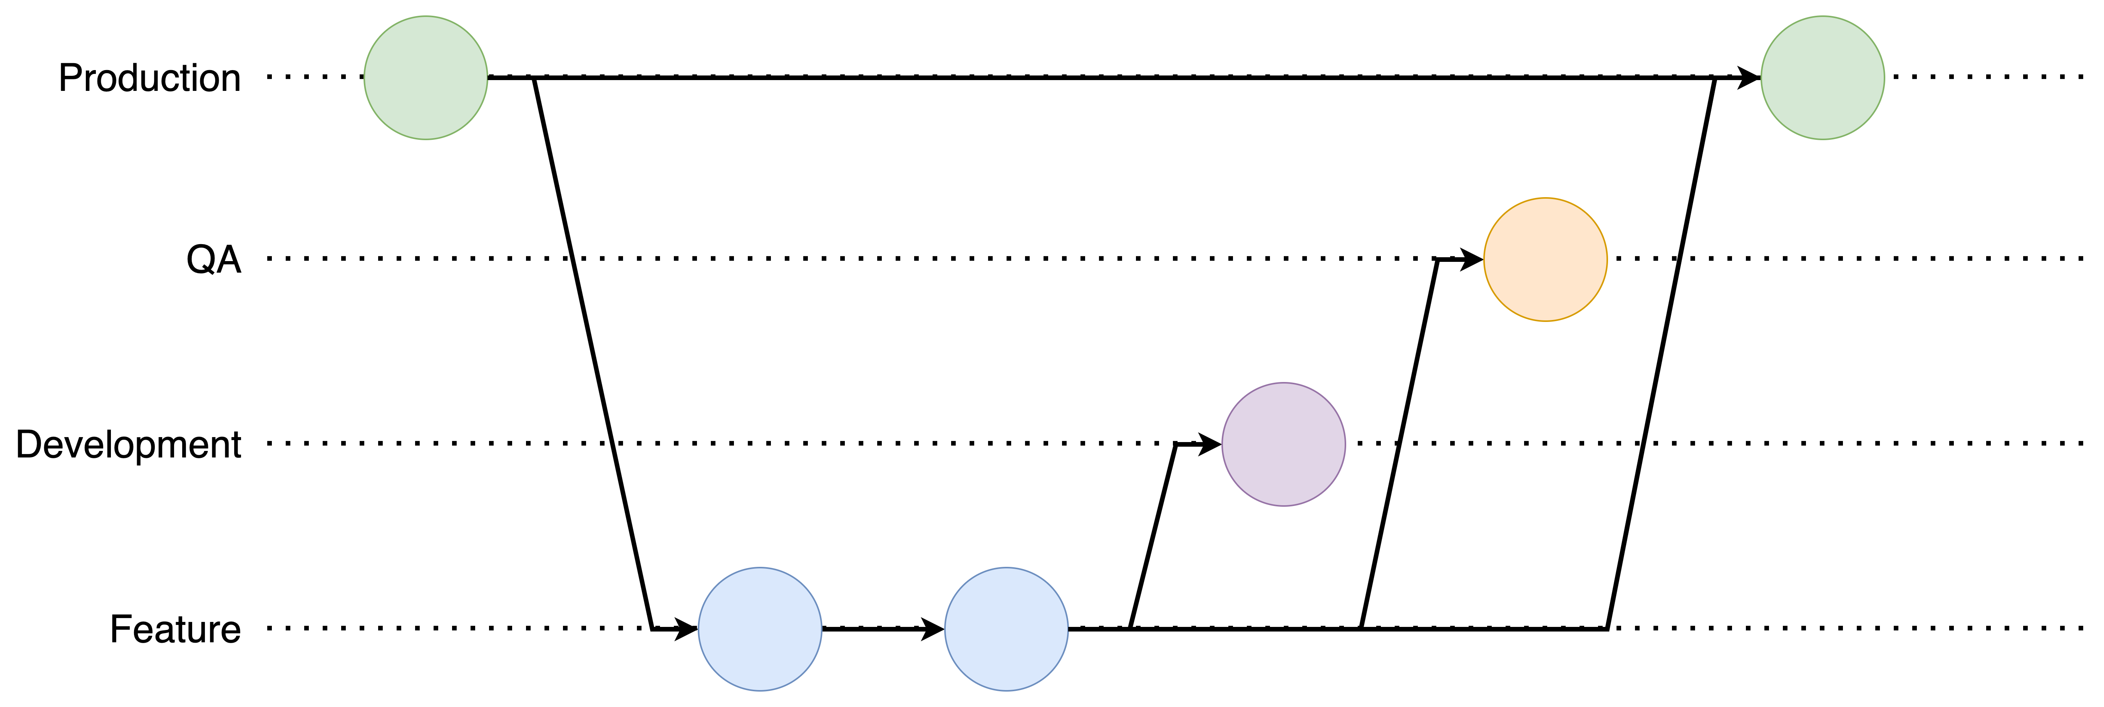
Overview
GIT Workflow
Notes:
Mention the Project / Repo approach.
That is each project will have its own reposirory.

Slide 6
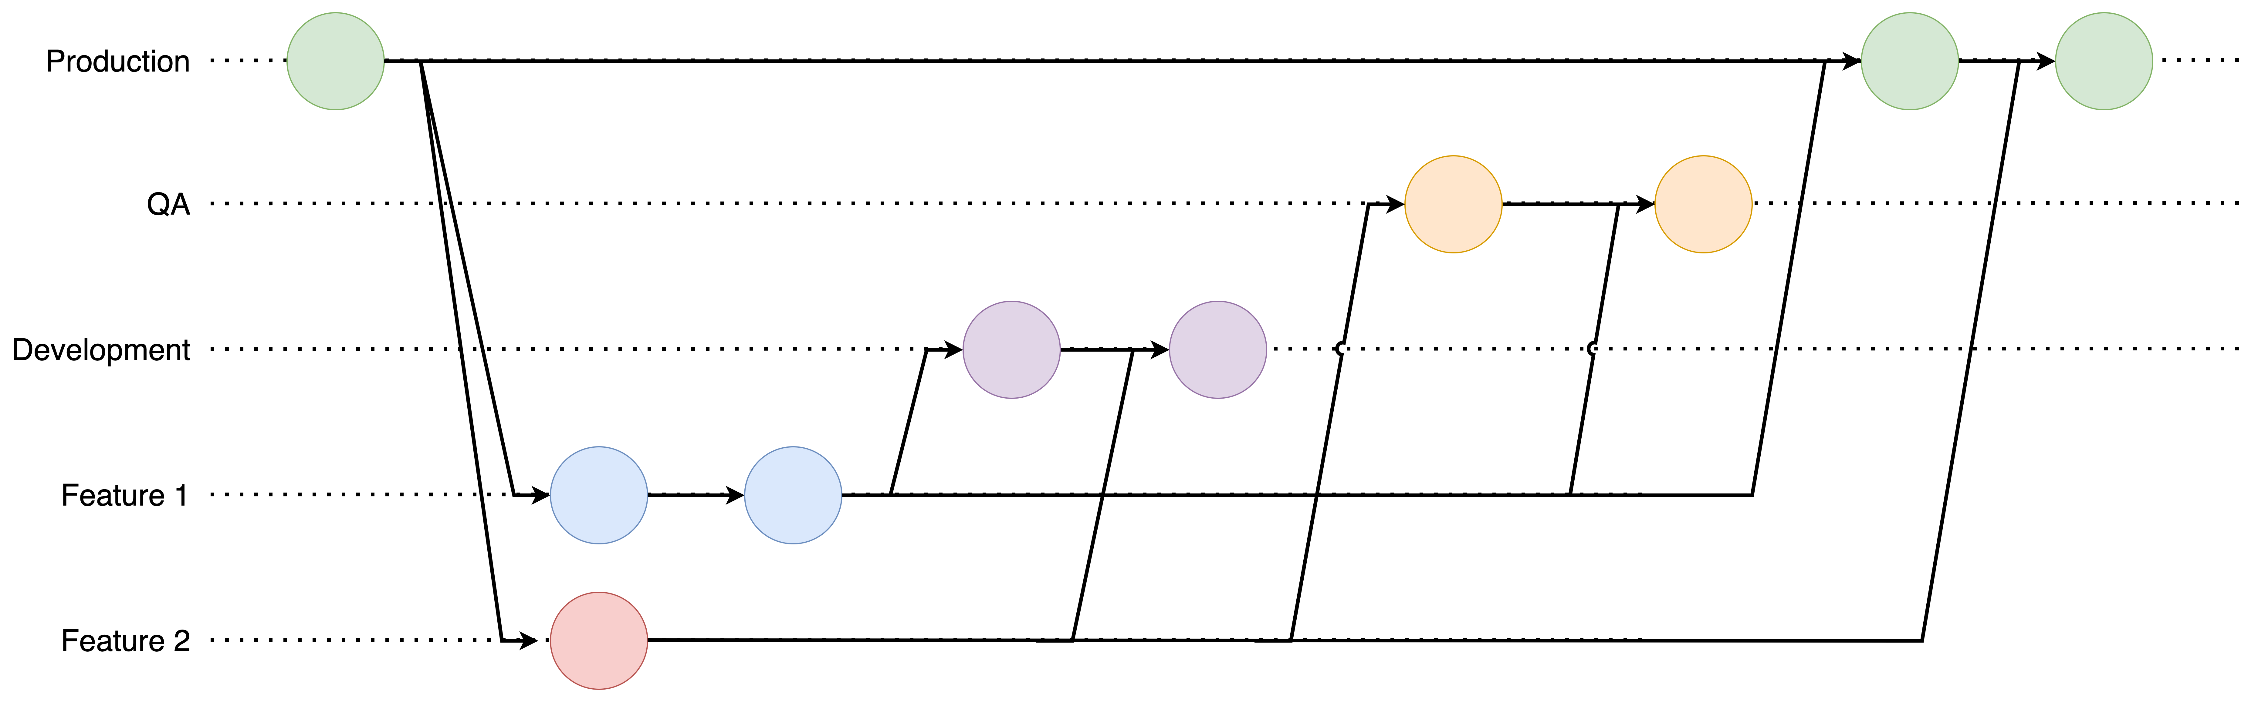
Overview
GIT Workflow

Slide 7
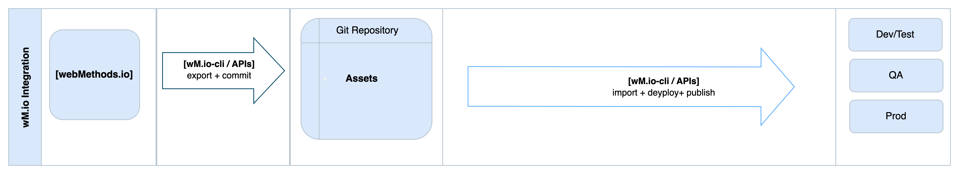
Overview
Delivery / Deployment Overview

Slide 8
Overview
Implementation to Delivery Flow

Slide 9
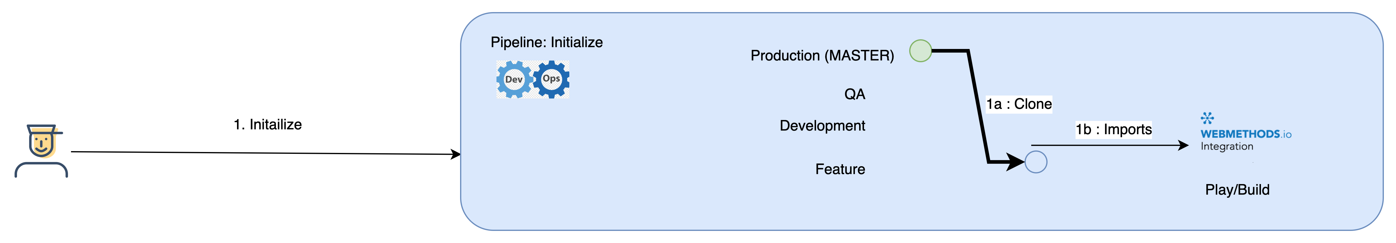
Overview
Implementation to Delivery Flow : Implementation
Developer starts by executing Initialize Pipeline (Automation)
This checks if the request is for an existing asset or a new implementation
If new, automation will
Initialize a repository
Create standardized branches, including requested Feature Branch
Create a project in Play/Build environment
If existing, automation will
Clone the Prod branch to Feature branch
Import asset to Play/Build environment

Slide 10
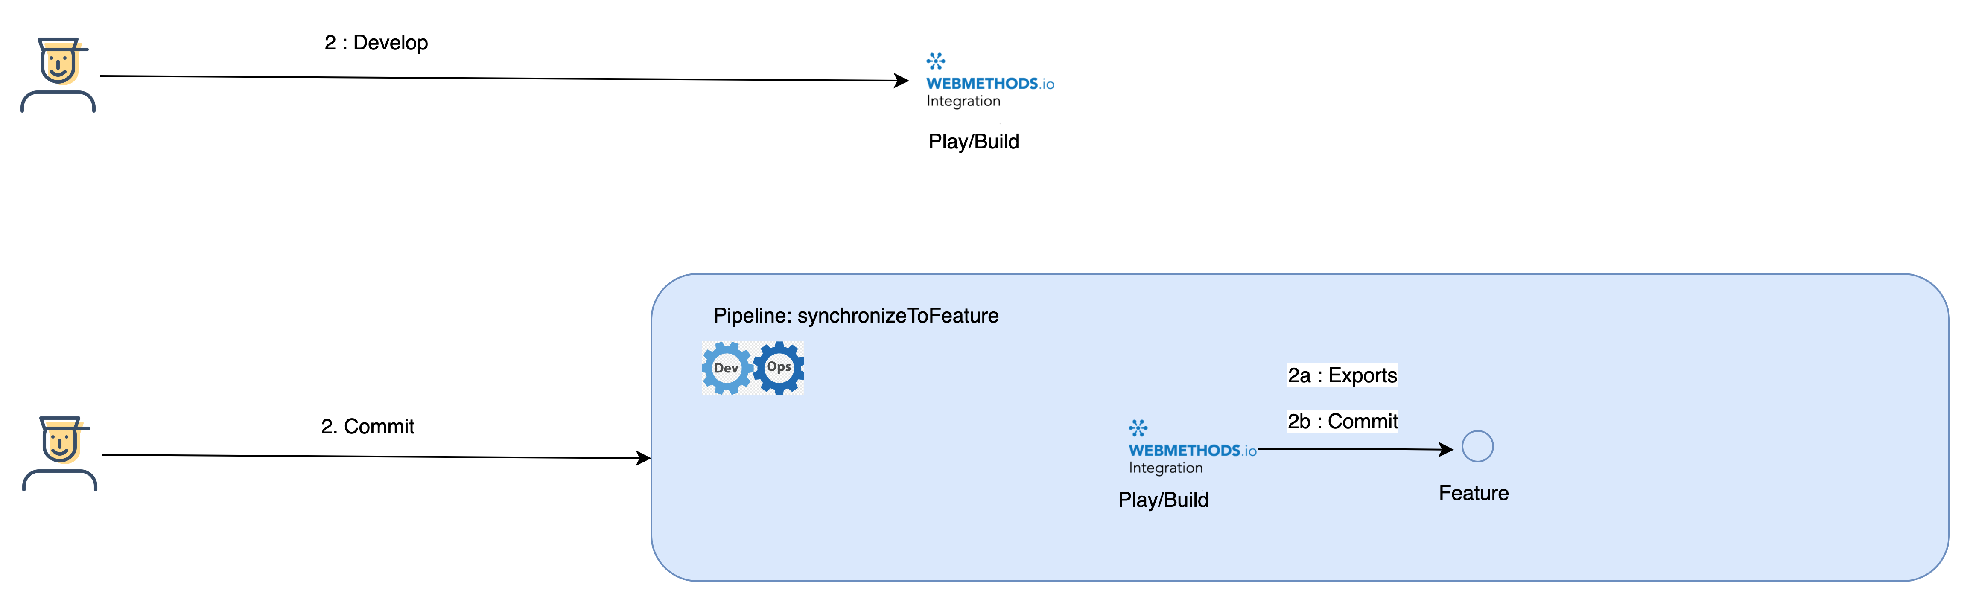
Overview
Implementation to Delivery Flow : Implementation
Developer starts developing
Once after completion he will execute synchronizeToFeature Pipeline (Automation)
Automation will
Export the asset
Commit the asset to Feature Branch

Slide 11
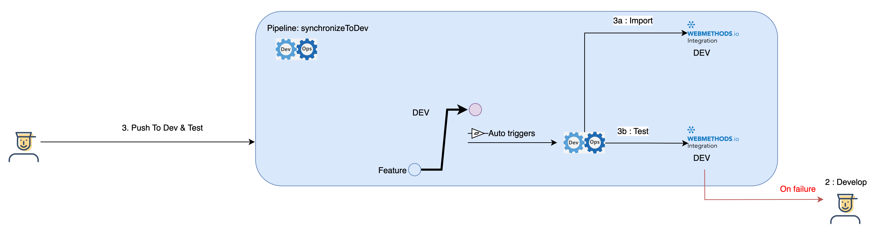
Overview
Implementation to Delivery Flow : Delivery DEV
Once the implementation is finished, developer manually creates a Pull Request from Feature Branch to DEV.
This will trigger the synchronizeToDev pipeline (Automation)
Automation will
Checkout the DEV branch
Import the asset to DEV environment
And then kicks of automated test for the associated project/repo with data/assertions specific to DEV
On Failure, developer needs to fix/re-develop the asset (Step 2).

Slide 12
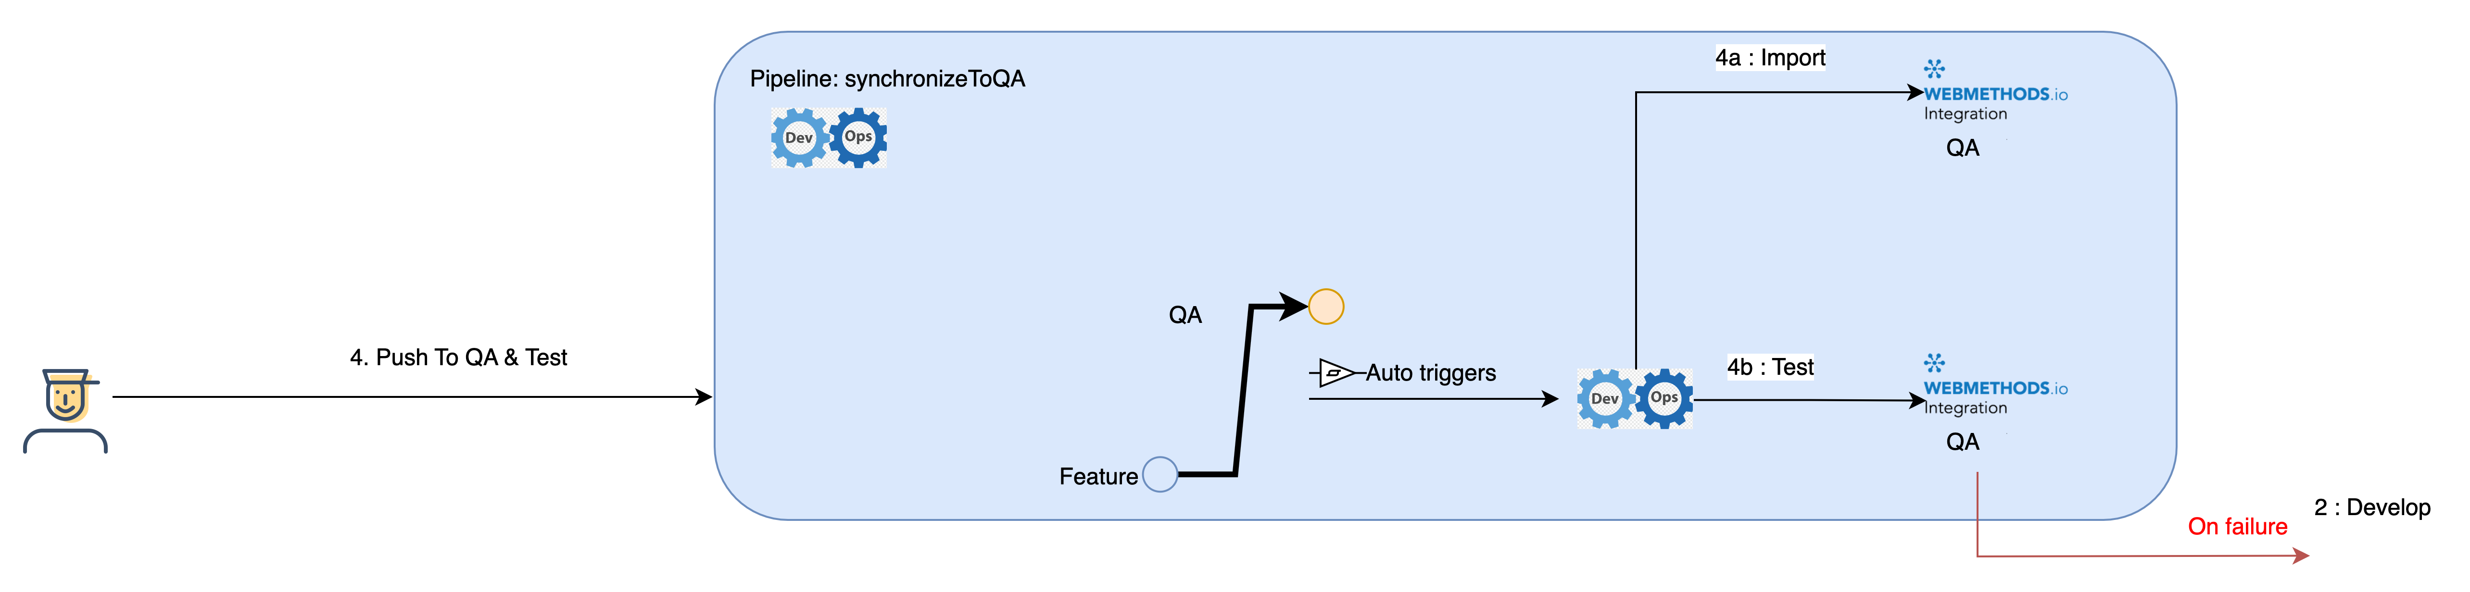
Overview
Implementation to Delivery Flow : Delivery QA
After Dev cycle is complete, developer manually creates a Pull Request from Feature Branch to QA.
This will trigger the synchronizeToQA pipeline (Automation)
Automation will
Checkout the QA branch
Import the asset to QA environment
And then kicks of automated test for the associated project/repo with data/assertions specific to QA
On Failure, developer needs to fix/re-develop the asset (Step 2).

Slide 13

Overview
Implementation to Delivery Flow : Delivery PROD
Once the automated test and UAT is successfully finished, developer manually creates a Pull Request from Feature Branch to PROD. PROD deployment may have different approval cycle.
Respective operations team will manually trigger the synchronizeToPROD pipeline (Automation)
Automation will
Checkout the PROD branch
Create a release
Import the asset to PROD environment
And then kicks of automated Smoke test, if any for PROD.
On Failure, developer needs to fix/re-develop the asset (Step 2). And release will be rolled back.

Slide 14
Show & Tell / Demo

Slide 15
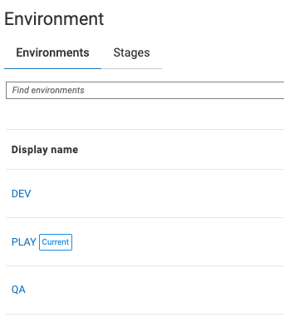
Demo
Scope, Assumptions & Pre-requisites
3 Environments
Play/Build, Dev & QA
Assets used for demo
2 Workflows (one with Sub FS), 1 Flowservice, Reference Data, Account (Only export), Project Parameters.
Automation / Orchestration platform
Azure DevOps
2 Repository Platforms
Github Enterprise for Pipelines/Scripts (Automations)
Github for actual webMethods IO assets
Test Framework
Postman / Newman & Azure Test Plans

Slide 16
Demo
Demo
Notes:
Cleanup
Initialize
Show Structure
Talk about Git Workflow
Accounts
Test
WorkflowID
Flowservice http flag
Mention and show (Tests could be triggered separately as well)
GitHub
Action
Key
SynchToFeature
Show Repo
Talk about structure
Reference Data/ config structure
Update DEV and QA configs
Show test results
Pull feature to DEV
Show the Dev Branch
Show Action/Workflow in Github
Show Azure
DEV triggered
Test results (falied)
Show DEV Tenant
Project
Workflow1
Webhook, Subflow
Workflow 2
Account not created
No Trigger
FS
Flag
Configs
PP
Ref Data
Update DEV Branch
Test:
Repo workflow id
Enable http
Rerun Manually DEV Test
Show Results
Pull feature to QA
Show tenant
Ref Data

Slide 17
What Next

Slide 18
Next Steps
Extend & Expand
Updates for raised features & issues
More connector tests
Integration with Hybrid / API DevOps (In Progress)
Test Coverage
Code Review

